Slide 1

Opportunities in Agro- processing industry in Ethiopia
Feb,2021

Slide 2
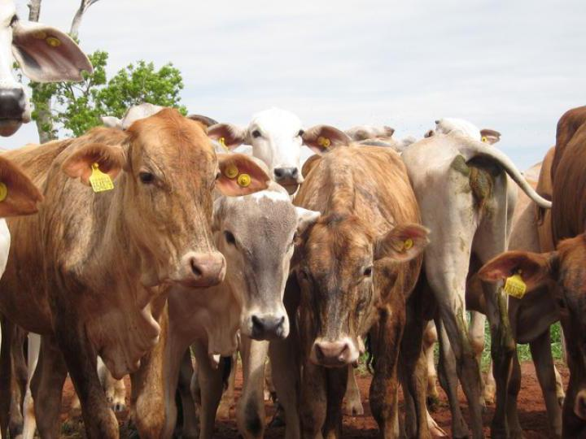

Ethiopia is a continental and global leader in the production of a variety of raw materials needed for Agro-processing Industries
5th
largest producer of tropical fruits in Africa
• 3rd
3rd
biggest producer of wheat in Africa
^{6th}
leading producer of livestock population globally
^{9th}
in chicken population in Africa

Slide 3
Ethiopia has key advantages for dairy, juice processing, edible oil processing industries
Dairy
Juice processing
Edible oil processing
Large stock of dairy cows and increasing milk inputs
Large domestic market
Need for non-refrigerated products.
Variable demand
Changing lifestyles
Favorable agro-ecological climate condition
can easily produce fruit all year
high potential areas for year-round.
Suitable land for organic fruits growing
Very limited juice processing plants
Abundant resources suitable for oilseed production.
Domestic processing of edible oil (~4% of supply),but increasing local demand,
Imports of edible oil covering ~95%
Still exports being in raw form, with no value addition

Slide 4
Ethiopia has the potentials for poultry, beef production and tomato processing
Po
Beef production
Tomato processing
Poultry
Large stock of dairy cows and increasing milk inputs
Large domestic market
Need for non-refrigerated products.
Variable demand
Changing lifestyles
Cattle is growing quickly
Cattle is a national priority
Ability to produce feed locally
The government is encouraging private investment to reach targets.
Geographic proximity to key consumer markets
Suitable climatic conditions.
Some of the lowest input costs
Competitive and mature air freight network

Slide 5

Agro-processing acts as a “Bridge” to long-term economic diversification opportunities for Ethiopia
Raw Produce
Auxiliary inputs to processing
Processing
Trading and marketing
Cereals, staples and industrial crops (coffee)
Packaging and labeling (e.g., cardboard boxes, glass bottles, and jars
Grain milling, dairy processing, fruits and vegetables, dried fruits and nuts, tomato paste, and some oil processing
Basic transport and logistics services; storage/warehouse services (cold/dry)
Current national advantages in agriculture in Ethiopia
Fruits and vegetables, some pulses
Animal husbandry, incl. cattle, poultry, shoats
Cartons, crates, lids, tins, plastic wrappers, sealable bags (poly-bags), tetra pack, paper labels, etc.
Pasta and biscuits, UHT milk, high quality feedlot/abattoir, edible oils, fresh-cut packaged F&V for export, etc
More advanced transportation and logistics; marketing and branding standardization & grading; financial services
Near-term diversification opportunities*
Long - term diversification opportunities*
Collection and packaging equip. manufacturing
Agri-mechanization, other industrial processing, and cold storage equipment
Logistical and other transport-related equipment manufacturing
Note: (*) Includes opportunities both for export growth and/or import substitution
Source: Ethiopian Agricultural Transformation Agency (ATA)

Slide 6
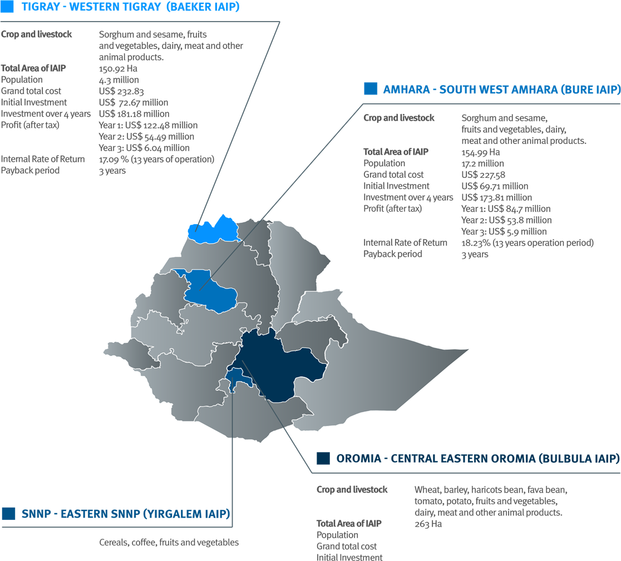
Industrial parks: Integrated agro- industrial parks are under construction, in the verge of being operational specialized for Argo Industry

Slide 7
Incentives: GoE is offering attractive incentives for manufacturers -Incentives that apply to agro-processors include
Exemption from duties and other taxes on imports of machinery, equipment, construction materials, spare parts, raw materials and vehicles
Income tax exemption for up to five years if 60% of products are exported.
Guarantee against expropriation and for repatriation of funds
Facilitation of market linkages
.
Full export duty exemption.
Subsidized land leasing to private entrepreneurs

Slide 8

www.investethiopia.gov.et

