Slide 1
Invest in Ethiopia
Investment Opportunities in the Agriculture sector
January 2021

Slide 2
Content
Background: favourable economic and political environment
Opportunities to invest in the agriculture sector
tailored Incentives , support measures and registration process

Slide 3
One of the fastest growing economies with 9.68% average growth over the past 10 years.
Ethiopia has a clear vision for industrialization that builds from its rapid economic growth
One of the top destinations for foreign direct investment, standing 5th in Africa.
Productive labor force with more than 60% of its population between the ages of 15 – 65.
Dedicated leadership with a vision to become a manufacturing hub in Africa by 2025.
A member of preferential trade agreements and bilateral investment treaties - COMESA, EBA,AGOA, etc.

Slide 4
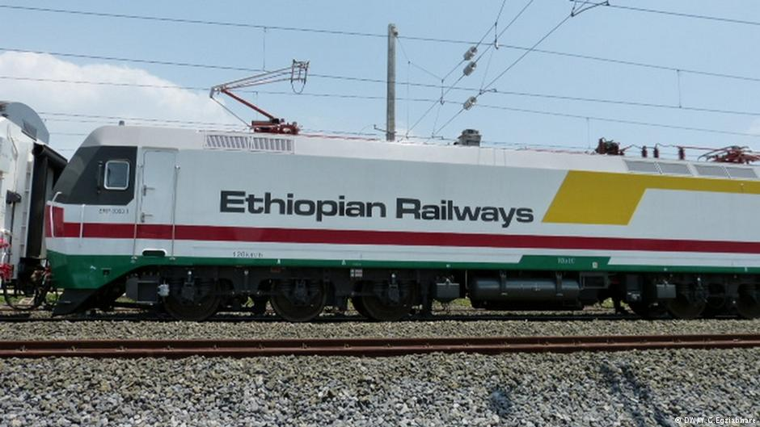
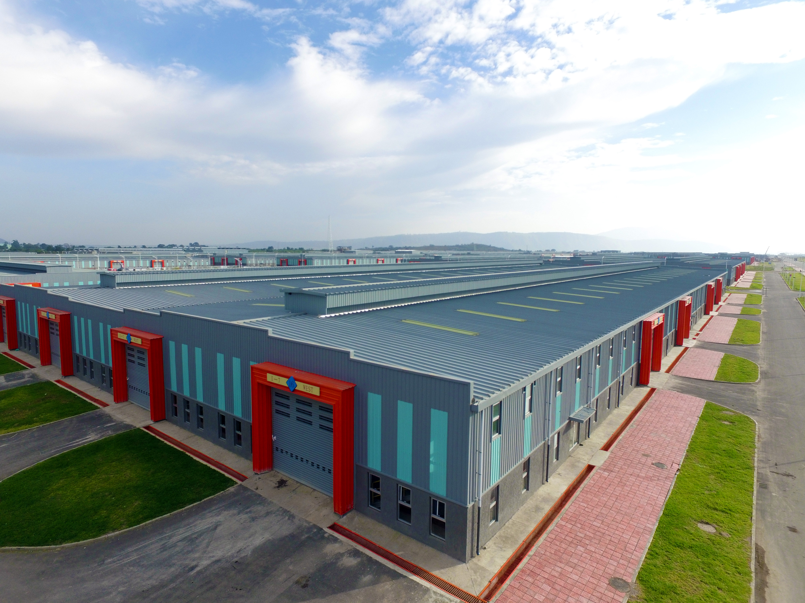
Ethiopia is building mega infrastructure projects to boost investment, which will capitalize on its existing geographic and market access advantages
Electricity rate: 0.28 cents/kwh
Massive investment in renewable energy generation
New electric railway connecting major economic corridors
Africa’s aviation hub: 127 international passenger, & 30 cargo destinations
Ethiopian Airlines: World-class airline
Industrial parks located in economic corridors
Specialized in priority sectors (including 4 agro-processing parks)
Generous incentives

Slide 5
Strategic sectors have been identified for investment including the Agriculture
Today’s focus
Pharmaceuticals
Energy
Agriculture
Agro-processing
Tourism
Textile
Floriculture
Leather

Slide 6
Content
Background: favourable economic and political environment
Opportunities to invest in the agriculture sector
tailored Incentives , support measures and registration process

Slide 7
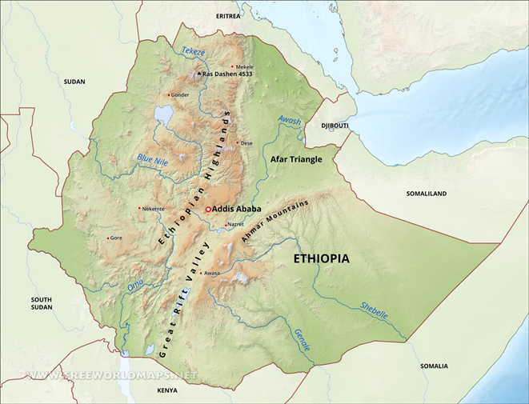
Overview of Ethiopia’s agriculture sector
1st in Africa & 6th in the world in coffee production
Abundant natural resources ( land, fertile soil, water and forests)
2nd largest exporter of flowers
> 70% young working age population
Diversified agro-ecologies
One of the first places where agriculture started
85% population depending on Agriculture
Source: Ministry of Agriculture (2020)

Slide 8
Why invest in production and processing of Ethiopia’s agricultural commodities?
Access to a ~$33 Bn Domestic market and a ~$313 Bn SSA market
Strong government support and competitive tax benefits
Abundant natural resources and infrastructure
A competitive and skilled-labor
pool
Growing middle income base and increasing consumer spend
Increasing productivity in the sector
Enabling policies, government reforms
A priority sector for the GoE, 10-year perspective plan drafted by Ministry of Agriculture (MoA) in line with the Home-Grown Economic Reform agenda
Integrated agro industrial parks
Ethiopia has abundant natural resources
The widest African air connectivity through Ethiopian Airlines
Well-developed train network includes 752 km transnational Ethiopia-Djibouti Railway
A well-developed road network of 121,200 kilometers
Abundant workforce with 28mn of the country’s population aged between 15-29 years
More than 300,000 university and 367,000 TVET graduates every year
Source: Agro-processing pitch document (FCDO and EIC, 2020); Ministry of Agriculture (2020)

Slide 9
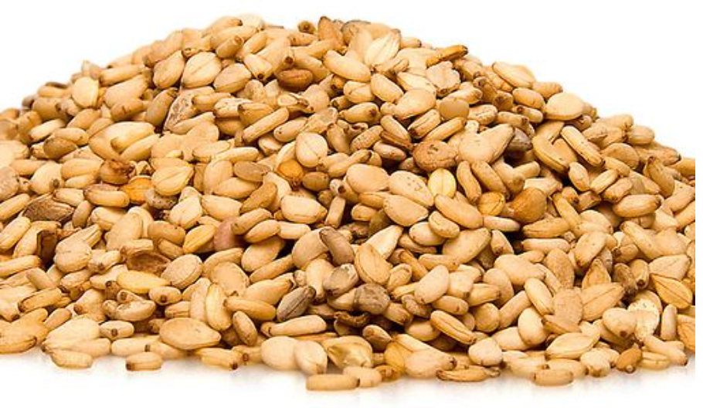
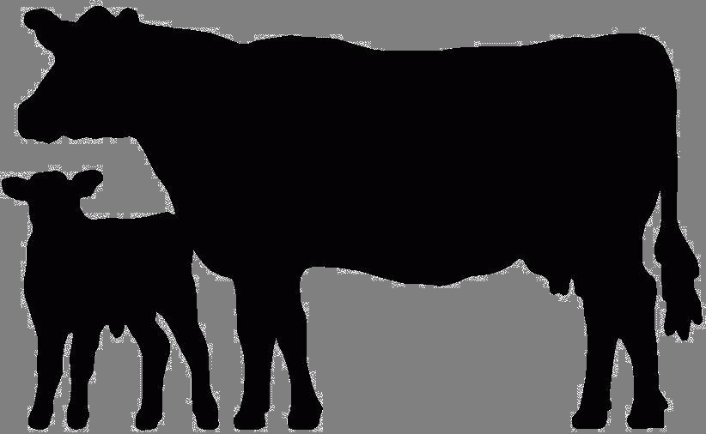
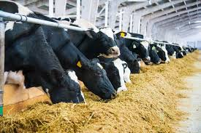
Major attractive business areas under agriculture
Sesame
Dairy
Animal Feed
Poultry
Ethiopia is the 9th top producer of Sesame globally (FAO, 2019). Niger seed, Sesame, Ground nuts, Linseed and soybeans are the top five products by volume
There is 204,000 ha of land suitable for sesame production
The sector benefits from a strong support from the GoE that has set an ambitious target for the sector
Short term to medium term: to increase local production of oilseed for end-to-end processing, replace imports
Long term: to become a net exporter of edible oil
Over the past 15 years, volume of cow milk production increased modestly from 1 billion to 4 billion liters
Total milk production in Ethiopia is 4.3 billion liters and per-capita milk consumption is 19 L/Year, compared to required 22 billion total production and 200 L per capita consumption to meet WHO and FAO Standards
There is 2.5mn ha of suitable land for dairy production and three public ranches that are soon to be privatized
Currently consumption of poultry products in Ethiopia is among the lowest in the world
The average per capita poultry consumption of Ethiopia is 0.5k. It is significantly lower than the Sub-Saharan Africa average of 2.3 kg
Imports of chicken meat increased by nearly 60% in a period of 10 years and risen by 32% between 2008-2013
There is a shortage of day-old chick (DOC) supply
Ethiopia has an attractive market for animal feed production, with unmet domestic demand estimated at USD 150mn and immense export potential
An estimate of 91 million tons of dried feed is annually produced; equivalent to 1.3 tons per year for the estimated 70 million cattle in the country (an average weight of 250 kg)
An estimated USD 8M in import-substitution opportunity
Potential to tap into USD 2.9B market in East and North Africa
Apart from the above areas, there are other lucrative businesses in which foreign investors can get involved such as production of wheat, floriculture, vegetables and fruits

Slide 10
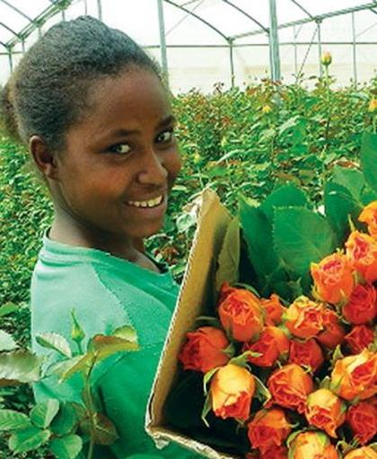
Ethiopia’s favorable climate, water and land resource all combined makes it an incredible hub for horticultural investment
Competitive Advantages of Investing in Horticultural Sector in Ethiopia
Strategic location at cross road between Africa, Middle east and Europe.
Diverse Agro-climatic zones;
Long growing seasons,
Temperature is conducive with long hours of sunshine.
Availability of abundant water for irrigation;
12 river basins, 18 natural lakes (including the Rift Valley Lakes).
122 billion cubic meters of surface water and 2.6 billion cubic meters of ground water
Availability of land;
Land area allocated for horticulture is about 12,552 ha, with only 11% of this land being developed for horticulture

Slide 11
Allocated land in Ethiopia suitable for organic certification
Investment opportunities in horticulture sector
Fruits and Vegetables
Fruits: Mango, banana, papaya, avocado, citrus, grape, pineapple, Pear and plum
Vegetable: green beans, snow peas, broccoli, okra, tomatoes, green chili, potatoes, cabbages cauliflower, eggplant, cucumber, pepper, onion, and asparagus
Land: suitable for organic certification for growing fruits and vegetables
Flowers
Roses are the most widely produced variety of flowers. Other types include gypsophilia, hypericum, Limonium, chrysanthemum, carnations, static and pot plants.
Supply 9% of global flower market.
Herbs and
Spices
Ginger, hot pepper, fenugreek, turmeric, coriander, cumin, cardamom, and black pepper.
Close to 122,700 hectares with spice production reaching 244,000 tons per year.
The total potential for low land spice farming is estimated to be 200,000 ha.

Slide 12
Content
Background: favourable economic and political environment
Opportunities to invest in the agriculture sector
Tailored Incentives, support measures and registration process

Slide 13
Proactive business environment – tailored incentives and support
Fiscal Incentives tailored to investment
Non-fiscal Incentives tailored to investment
Establishment
Miscellaneous
Exemption from income tax ranging from 3 to 9 years depending on the type of investment within the sector
Exemption from duties and other taxes on imports of machinery, equipment, construction materials, spare parts, and vehicles
Loss-carry forward
Full export duty exemption
Guarantee against expropriation
Guarantee for repatriation of funds
All the necessary licenses to get started in Ethiopia are issued by the Ethiopian investment commission
The Commission provides a wide range of support services to expedite acquisition of land and basic utilities
Expedited visa procedure - expedited procedure of securing entry, work permit and certificate of residency
Multiple entry visas for share holders and general managers
Facilitation of market linkages
One-Stop Shop Service under the EIC - including pre-establishment licensing and registration and post-establishment after-care services
Source: Ministry of Agriculture (2020)

Slide 14
THANK YOU!

