Slide 1
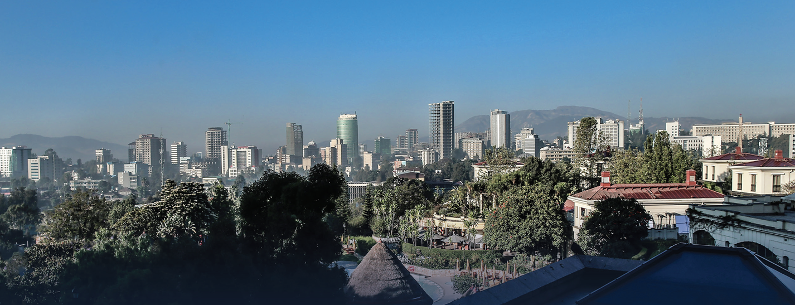
INDUSTRIAL PARK DEVELOPMENT IN ETHIOPIA?

Slide 2
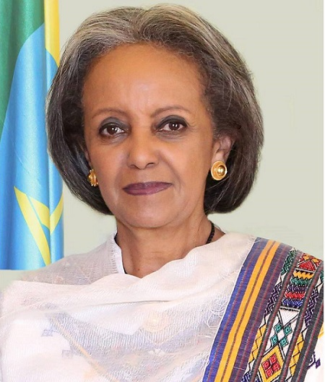
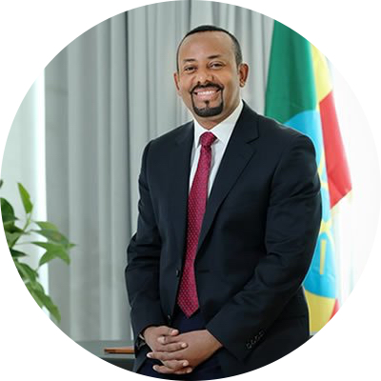
Ethiopia at a glance
Governance structure
Federal government structure
9 semi-autonomous regions; 2 chartered cities
Parliamentary system
President: Sehale-Work Zewde
Head of State
Prime Minister: Dr Abiy Ahmed
Head of Government
Official Name
Federal Democratic Republic of Ethiopia
Economics
GDP- 84.35 USD Bn
GDP growth rate: 10%
Location
Horn of Africa, at the crossroads between Africa, the Middle East and Asia
Demographics
Population: ~105 Mn (2017), second most populous country in Africa
Population growth (annual %)- 2.5%
Life expectancy- 65 years
Area
1.1 million square kilometers
Notes:
“Stellar FDI performance” (World Bank)
Led by investment in manufacturing sector
Top 3 FDI destination in Africa (UNCTAD 2017)
2nd largest recipient of FDI in the apparel & textile industry (UNCTAD 2017)

Slide 3
The country has set the vision to become the leading manufacturing hub of Africa and a preferred destination for FDI by 2025
KEY GOVERNMENT STRATEGIES TO ATTAIN VISION
1
Targeted investment in priority areas
2
Development of world-class industrial parks fitted with sustainable infrastructure
3
Tailored incentives
4
Conducive enabling environment
DEEP DIVE FOLLOWS

Slide 4
Ethiopia has undergone significant changes over the last year; opening up of the economy is currently underway

Slide 5
…….
Industrial park key characteristics
Located along strategic economic corridors, connected to ports by electric driven railway lines and asphalt roads with Close proximity to abundant labor force
Ready for plug-and-play, equipped with all the necessary infrastructure including waste water treatment plants with joint calibration
Dedicated power with own sub-station and state of the art waste treatment facilities with a dedicated park administration and support system
Health stations, fire brigade, expats accommodation and 24 hours security services
One Stop Services (OSS) including processing & issuance of permits, licenses, registration certificates, agreements, tax identification number, customs clearance, banking services.
SECTOR
SPECIALIZATION
EXPORT ORINTED
VERTICALY INTEGERATED
SUSTAINABILITY
SKILL DEVELOPMENT

Slide 6
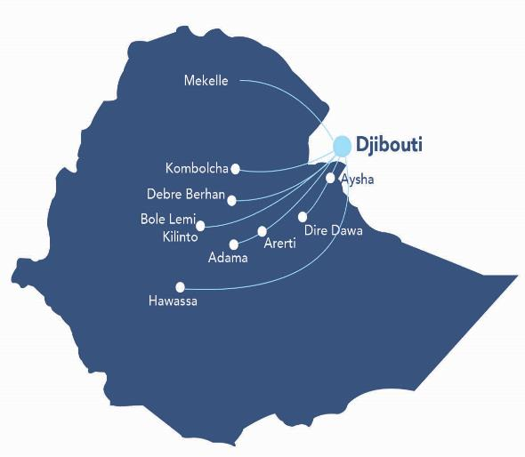
Several industrial Parks are being developed through out the country
27
Total planned Industrial Parks
13
Government owned IPs operational
Bahir Dar
8
Private IPs fully operational
Eastern and Hujian Industry Parks
12
Government Industrial Parks
Jimma
13
IPs (State and private) under construction
10
Private Industrial Parks
Construction not started
Under construction
Operational

Slide 7
Current status of Ips’ In Ethiopa
Public IPs
IP Name
Construction status
Operational status
Bole Lemi I
100%
Bole Lemi II
80%
Kilinto
80%
Hawassa I
100%
Hawassa II
95%
Adama
95%
Dire Dawa
95%
Mekelle
100%
Kombolcha
100%
Jimma
50%
Bahir Dar
50%
Arerti
NA
Aysha
NA
Debre Berhan
60%
Ready
Operational

Slide 8
Privately owned industrial parks status
IP Name
Specialization
Location
Total size
Operational status
Eastern IP
Mixed
Dukem
400 ha
George Shoe
Leather processing & products
Modjo
86 ha
Huajian Group
Mixed
Lebu
138 ha
CGCOC
NA
Debre Berhan
122 ha
CCCC
Construction material & home appliance
Arerti
100 ha
CCECC
Mixed
Dire Dawa
1000 ha
Kingdom
Textile and garment
Adama
32 ha
Vogue
Textile and garment
Mekelle
176.7 ha
Hunjian
Heavy machineries & equipment
Adama
120 ha
Sunshine
Textile and garment
Adama
80
Operational

Slide 9
Industrial park and incentives facilities
Incentives
Fiscal Incentives
Exemption from income tax up to 15 years for Industry Park developers
Exemption from income tax up to 8 - 10 years for enterprises inside IPs,
Exemption from duties and other taxes on imports of machinery, equipment, construction materials, spare parts, raw materials and vehicles
Loss carry forward
Row material duty free importation
Customs facilitation through bonded export factory and similar other schemes
Guarantee against expropriation
Guarantee for repatriation of profit..
Relaxed Industrial park land regime - 60-80 years charge-free lease for IP Developers, discounted lease rate for IP Enterprises
Non Fiscal Incentives
Source: EIC analysis

Slide 10
Necessary documents and steps to Develop Industrial park
Economic feasibility study document
Park development plan
Hydrological study
Evidence of financial capacity
project permit from pertinent governmental institutions social and environmental compatibility

Slide 11
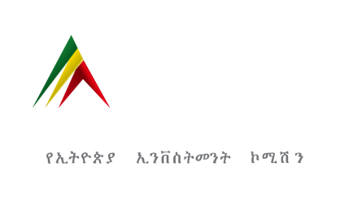
Thank You!
We Welcome you to invest in the fast growing Ethiopia
For further reference our website is: www.investethiopia.gov.et

