Slide 1
PPP Projects Pipeline 2020/2021

Slide 2
Existing PPP Pipeline in Ethiopia

Slide 3
Hydro
Saudi Arabia
N
Sudan
Red Sea
Name of the Project | Installed capacity in MW | Cost est. in MUSD
Yemen
Eritrea
Genale Dawa 6 | 469.8 | 246.0
Gulf of Aden
Chemoga-Yeda
Chemoga-Yeda | 280.0 | 729.0
Addis Ababa
Abay
Somalia
Dabus | 798.0 | 984.0
Dabus
Awash
Halele-Warabessa | 424.0 | 1196.0
Halele-
Werabesa
GD 5
GD 6
Omo
Wabe Shabele
Sudan
Genale
Genale Dawa 5 | 100.0 | 387
Indian Ocean
Kenya
 |  | 2,071.8 | 4,725
Scale
0
250
500
750
Kilometres

Slide 4
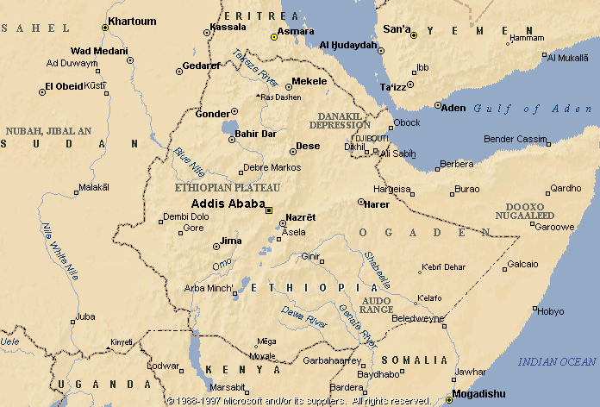
Solar
Name of the Project | Installed capacity in MW | Cost est. in MUSD
Solar Dicheto | 125 | 150
Solar Gad | 125 | 150
Solar Humera | 100 | 120
Solar Mekele | 100 | 120
Solar Welenchetti | 150 | 165
Solar Weranso | 150 | 165
Solar Hurso | 125 | 150
Solar Metema | 125 | 150
 | Total | 1,000 | 1,170
Source: EEP

Slide 5
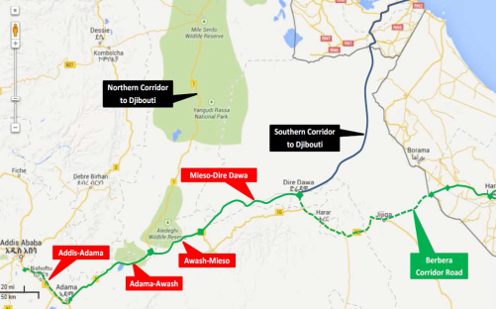
Expressways
Preliminary Financial Analysis
The estimated total construction cost for the 3 sections i.e. from Adama to Dire Dawa is estimated at US$ 1,119 million, including US$ 38 million towards the costs of capitalized interest. The cost of land acquisition is yet to be estimated. Below is a breakdown of the projected costs by section.
Section | Length (kms) | Unit cost (US$m/km) | Total cost (US$ m)
Adama Awash | 125 | 3.48 | 435
Awash Mieso | 72 | 2.78 * | 200
Mieso - Dire Dawa | 160 | 2.78 * | 445
Capitalized interest |  | 39
Total |  | 1,119
*Lower unit cost due to fewer lanes i.e. single carriage way with provision for widening
Source: ERA based on IFC Preliminary Analysis

Slide 6
Public-Private Partnership Projects Current Status
R.No. | Name of Projects | Current Status | Remark
1. | Gad and Dicheto Solar PV Projects (250MW) | The winning bidder (ACWA Power) achieved commercial close on Dec. 19/2019 and now working on outstanding CPs to reach Financial Close (17 PCs) Achievement: Energy Tariff 2.5260 US Cents per Kwh. | The winning bidder Expected to arrive Financial Close in the mid of April 2021 ( Financial Close was planned to be completed in June 2020 but extended two times due to COVID-19 and convertibility guarantee)
2. | Gad-II Solar Power Projects (Round IIA) (125MW) | RFP and Relevant documents are uploaded in the Data Room and Clarification Q & A are underway ahead of bid submission The E&S team begun conducting the study on July 22/2020 for Gad-II E&S work are underway and expected to be finalized in Feb/2021 Pre-bid Conference will be held on VC Bidders site visit will be held through Drone Footage | The anticipated bid submission deadline is on April 14/2021 (the bid submission was initially scheduled for June 2020 however, it was extended to December 2020 and now to April due to COVID-19)

Slide 7
Public-Private Partnership Pojects Current Status Cont.
R.No. | Name of Projects | Current Status | Remark
3. | Weranso Solar Project (Round IIA) (100) | RFP, PPA and IA document are completed Project site is under investigation | The Regional State noted that the site for Weranso Solar Project is within the National Park area and it is not suitable for the project. Now EEP and the Regional States identified an alternative site and agreed to tender the project.
4. | Metema, Mekele/Shiraro, Humera and Welenchiti Solar Projects (Round IIB) (475MW) | Prequalified bidders were identified using RFQ document IFC team will start site related studies to tender the projects in 2021. | EEP recommended to find an alternative sites for the projects since Mekele site has high social risk, Welenchiti site has volcanic rock, and Metema site has security issue. Therefore, EEP and IFC are working together to find an alternative sites.

Slide 8
Public-Private Partnership Projects Current Status Cont.
R.No. | Name of Projects | Current Status | Remark
5. | Hydropower Projects Genale Dawa-6 (246MW) Genale Dawa-5 (100MW) Halale Werabesa I & II (424MW) Chemoga Yeda I & II (280MW) Dabus (798MW) | Consultant has been retained by CA to update the feasibility study, ESIA and RAP Draft RFQ prepared for Chemoga Yeda I & II and Dabus | The feasibility studies, ESIA, and RAP conducted before 15 =20 Years to implement by traditional procurement. Therefore, it requires update based on PPP concept.
6 | Express Road Projects Adama-Awash (60Km) Awash-Mieso (72Km) Mieso-Dire Dawa (160Km) | Consultant retained by CA for detailed feasibility study, ESIA and other Tender Documents | The consultant submitted the draft studies. However, theWorld bank and AfDB have shown interest no to provide guarantee to the projects. The projects likely will be excluded from PPP pipeline.

Slide 9
Public-Private Partnership Projects Current Status Cont.
R.No. | Name of Projects | Current Status | Remark
9. | Affordable Housing in Addis Ababa | Project Management Team has been established by the CA Consultant has been retained for detailed feasibility study, ESIA and tender documents and preparation, and the work has started.
10. | Ethio-Djibouti Railway INDODE Terminal Logistic Project | Project Management Team had been established by the CA The Project Management Team prepared the TOR to hire consultant for detailed feasibility study, ESIA and Tender documents. | PPP Board did not approve the project

Slide 10
PPP Capacity building and Knowledge management Directorate
Director, Ashenafi Abera
+251 912 16 21 08
pppethiopiaashenafi@gmail.com

